Slide 1
RUNGTA COLLEGE OF DENTAL SCIENCES AND RESEARCH
REGENERATIVE ENDODONTICS
DEPARTMENT OF CONSERVATIVE DENTISTRY AND ENDODONTICS

Slide 2
Specific learning Objectives
At the end of this presentation the learner is expected to know ;
Core areas* | Domain ** | Category #
Introduction | Cognitive | Nice to know
Definitions | Cognitive | Must know
Indications | Cognitive | Must know
Single vs Multiple visit endodontics | Cognitive | Must know

Slide 3
CONTENT
INTRODUCTION
HISTORY
DEFINITIONS
PRESENT SCENARIO OF REGENERATIVE ENDODONTICS
GOALS & OBJECTIVES
TRILOGY OF REGENERATION
Stem Cells
Growth Factors/Morphogens
Scaffolds
Delivery System
CLINICAL STUDIES ON REGENERATIVE ENDODONTICS
Clinical Procedures Related to Regenerative Endodontics
Overview of Clinical Revascularization Cases
AAE Revascularization Protocol
Newer Approaches for regenerative endodontics
Clinical Measures of Treatment Outcome
CONCLUSION
REFERENCES

Slide 4
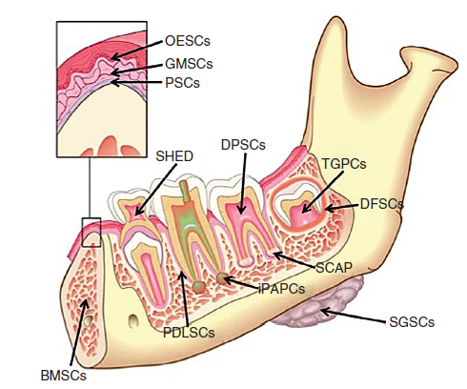
Dental stem cell
Epithelial stem cell
Mesenchymal stem cell
Inflammatory Periapical Progenitor Cells (IPAPCs)
Stem Cells Of The Apical Papilla (SCAP)
Dental Follicle Stem Cells (DFSCs)
Dental Pulp Stem Cells (DPSCs)
Bone Marrow Stem Cells (BMSCs)
Tooth Germ Progenitor Cells (TGPCs)
Salivary Gland Stem Cells (SGSCs),
Stem Cells From Human Exfoliated Deciduous Teeth (SHED)
Oral Epithelial Stem Cells (OESCs),
Gingival-derived Mesenchymal Stem Cells (GMSCs)
Periosteal Derived Stem Cells (PSCs)
CLASSIFICATION OF
DENTAL STEM CELLS
Egusa H et al: Stem cells in dentistry—part I: stem cell sources, J Prosthodont Res

Slide 5
FUNDAMENTAL PROPERTIES OF STEM CELLS
Undifferentiated cells | Have not developed into a specialized cell type
Long- term self- renewal | The ability to go through numerous cycles of cell division while maintaining the undifferentiated state
Production of progenitor cells | Capacity to differentiate into specialized cell types. ( eg. Odontoblast, osteoblast, adipocyte, fibroblast)

Slide 6
DENTAL PULP STEM CELLS (DPSCS)
DPSCs - isolated in 2000 by Gronthos et al.
dentin-pulp-like complex composed of a mineralized matrix of tubules lined with odontoblasts, and fibrous tissue containing blood vessels in an arrangement similar to the dentin-pulp complex

Slide 7
STEM CELLS FROM THE HUMAN EXFOLIATED DECIDUOUS TEETH (SHED)

Slide 8
SHED - isolated in 2003 by MIURA et al
Main task → formation of mineralized tissue→ enhance oro-facial bone regeneration.
Higher proliferation rate than stem cells from permanent teeth
Generates dentin-pulp like tissue with distinct odontoblast like cells.

Slide 9
ADVANTAGES:
Can be retrieved from a tissue that is disposable and readily accessible
SHED banking is more economical when compared to cord blood and may be complementary to cord cell banking
Ideally suited for young patients at the mixed dentition stage who have suffered pulp necrosis in immature permanent teeth as a consequence of trauma.
SHED may also be useful for close relatives of the donor such as grandparents, parents and siblings

Slide 10
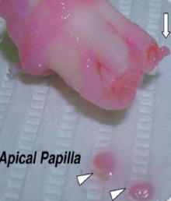
STEM CELLS OF APICAL PAPILLA (SCAP)
SCAP – isolated in 2008 by SONOYAMA et al.
Located at the apex of developing human permanent teeth and termed this tissue apical papilla.
Essential for root development
Loosely attached to the apex of the developing root and can be easily detached with a pair of tweezers.
SCAP are capable of forming odontoblast-like cells, producing dentin in vivo.

Slide 11
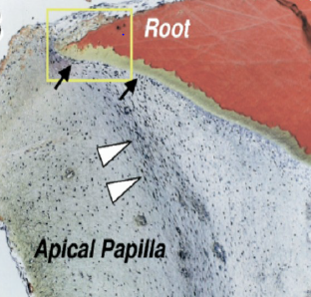
Collateral circulation due to its proximity to the periapical tissue vasculature
Survive during the process of pulp necrosis.
After endodontic disinfection→ SCAP can generate primary odontoblasts
Complete root formation under the influence of the surviving epithelial root sheath of hertwig

Slide 12
Cells are clonogenic and can undergo odontoblastic, adipogenic or neurogenic differentiation.
SCAP show higher proliferation rates than DPSCS

Slide 13
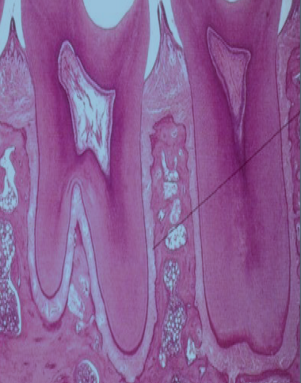
PERIODONTAL LIGAMENT STEM CELLS (PDLSCS)
PDLSCS- isolated in 2004 by SEO et al.
Present as multipotent postnatal stem cells in the human PDL
Generate a cementum/pdl-like structure
Contributed to periodontal tissue repair

Slide 14
MORPHOGENS/GROWTH FACTORS
Growth factors are proteins that bind to receptors on the cell and induce cellular proliferation and/or differentiation.
GROWTH FACTORS → CONTROL STEM CELL ACTIVITY SUCH AS
Stimulating stem cells to synthesise & secreate mineralized matrix
By increasing the rate of proliferation
Inducing differentiation of the cells into another tissue type

Slide 15
Abbreviation | Factor | Primary Source | Activity | Usefulness
BMP | Bone morphogenetic proteins | Bone matrix | Differentiation of osteoblasts and mineralization of bone | Make stem cells synthesize and secrete mineral matrix
CSF | Colony stimulating factor | A wide range of cells | Stimulate the proliferation of specific pluripotent bone stem cells | Increase stem cell numbers
EGF | Epidermal growth factor | Submaxillary glands | Proliferation of mesenchymal, glial and epithelial cells | Increase stem cell numbers
FGF | Fibroblast growth factor | A wide range of cells | Proliferation of many cells | Increase stem cell numbers
IGF | Insulin-like growth factor-I or II | I - liver II–variety of cells | Proliferation of many cell types | Increase stem cell numbers

Slide 16
IL | Interleukins IL-1 to IL-13 | Leukocytes | Stimulate the humoral and cellular immune responses | Promotes inflammatory cell activity
PDGF | Platelet-derived growth factor | Platelets, endothelial cells,placenta | Proliferation of connective tissue, glial and smooth muscle cells | Increase stem cell numbers
TGF-α | Transforming growth factor alpha | Macrophages, brain cells,and keratinocytes | Important for normal wound healing | Induces epithelial and tissue structure development
TGF-β | Transforming growth factor-beta | Dentin matrix, activated TH1 cells (T-helper) and natural killer (NK) cells | antiinflammatory, promotes wound healing, inhibits macrophage and lymphocyte proliferation | Present in dentin matrix and has been used to promote mineralization of pulp tissue

Slide 17
SCAFFOLDS
Cells are often implanted or 'seeded' into an artificial structure capable of supporting three-dimensional tissue formation→ called scaffolds
Scaffolds serve at least one of the purposes:-
Allow cell attachment & migration
Deliver & retain cells& biochemical factors
Enable diffusion of vital cell nutrients & expressed products
Provide structural support & shape to construct

Slide 18
Scaffolds are three‑dimensional (3D) porous solid biomaterials designed which
Provide a spatially correct position of cell location
2. Promote cell‑biomaterial interactions, cell adhesion, and ECM deposition
3. Permit sufficient transport of gases, nutrients, and regulatory factors to allow cell survival, proliferation, and differentiation
4. Biodegrade at a controllable rate that approximates the rate of tissue regeneration
5. Provoke a minimal degree of inflammation or toxicity in vivo

Slide 19
IDEAL REQUIREMENTS OF A SCAFFOLD
A high porosity and an adequate pore size → cell seeding and diffusion throughout whole structure of both cells and nutrients
b. Should allow effective transport of nutrients, oxygen, and waste
c. Biodegradability is essential → without the necessity of surgical removal
d. rate of degradation occurs has to coincide with the rate of tissue formation
e. Should be biocompatible
f. Should have adequate physical and mechanical strength.

Slide 20
optimal → between 200 and 400um
effect on its mechanical
integrity and its ability to
perform under functional
demands
important role in cell
proliferation and cell
distribution throughout
tissue regeneration
Pore size

Slide 21
Classification of scaffolds
• Based on degradability of matrices
• Based on form
• Based on presence or absence of cells
• Based on origin

Slide 22
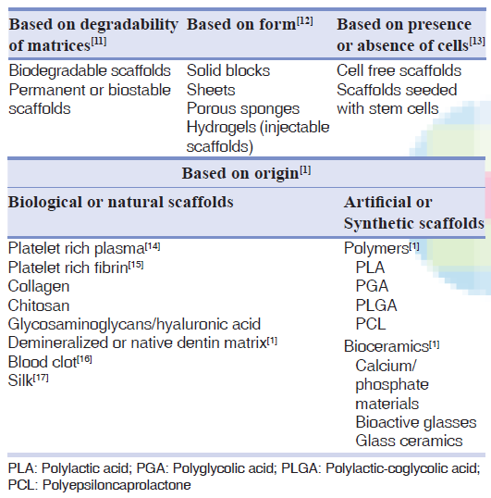

Slide 23
TAKE HOME MESSAGE
The clinical success rates of endodontic treatment can exceed 90%, regenerative endodontic methods have the potential for regenerating pulp and dentin tissues and therefore may offer an alternative method to save teeth that may have compromised structural integrity.
However the most challenging aspects of developing a regenerative endodontic therapy is to understand how the various component procedures can be optimized and integrated to produce the outcome of a regenerated pulp-dentin complex
The future development of regenerative endodontic procedures will require a comprehensive research program directed at each of these components and their application to our patients. The unleashed potential of regenerative endodontics may benefit patients.

Slide 24
QUESTIONS
Give classification of dental stem cells.
Define scaffold.

Slide 25
REFERENCES
Cohen’s pathway of pulp- first south Asian edition
Grossman’s ENDODONTIC PRACTICE-13th edition
Regenerative Endodontics, SAMI M.A CHOGLE,BDS,DMD,MSD, HAROLD E. GOODIS,DDS, DENTAL CLINICS OF NORTH AMERICA, july 2012,volume 56, number 3.
Regenerative Endodontics: A Review of Current Status and a Call for Action Peter E. Murray, BSc(Hons), PhD,* Franklin Garcia-Godoy, DDS, MS,† and Kenneth M. Hargreaves, DDS, PhD‡JOE — Volume 33, Number 4, April 2007.
Yoshpe M, Einy S, Ruparel N, Lin S, Kaufman AY. Regenerative Endodontics: A Potential Solution for External Root Resorption (Case Series). Journal of Endodontics. 2020 Feb 1;46(2):192-9.
Cymerman JJ, Nosrat A. Regenerative endodontic treatment as a biologically based approach for non-surgical retreatment of immature teeth. Journal of endodontics. 2020 Jan 1;46(1):44-50.
Kim SG, Malek M, Sigurdsson A, Lin LM, Kahler B. Regenerative endodontics: a comprehensive review. International endodontic journal. 2018 Dec;51(12):1367-88.

Slide 26
THANKYOU

